Slide 1
Big Data Project 1
Brennan Chan & Phuong Thai

Slide 2
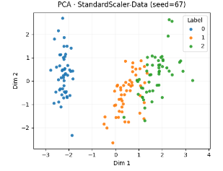
Iris Data PCA with Standard Scaler

Slide 3
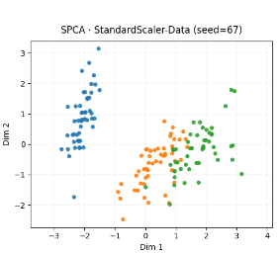
Iris Data SPCA with Standard Scaler

Slide 4
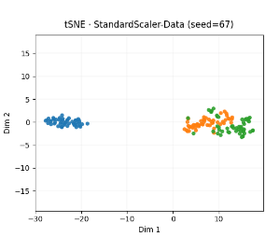
Iris Data t-SNE with Standard Scaler

Slide 5
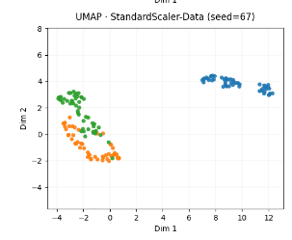
Iris Data UMAP with Standard Scaler

Slide 6
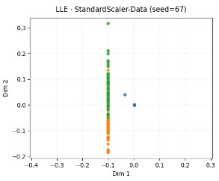
Iris Data LLE with Standard Scaler

Slide 7
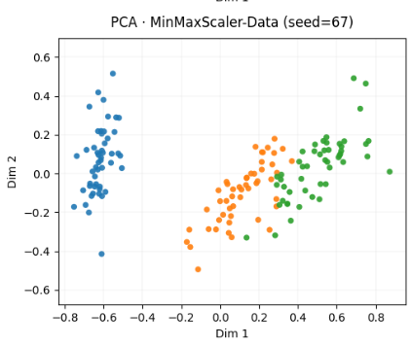
Iris Data PCA with MinMax Scaler

Slide 8
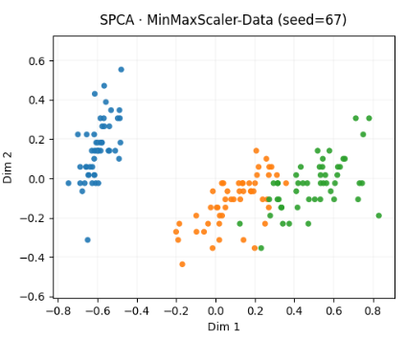
Iris Data SPCA with MinMax Scaler

Slide 9
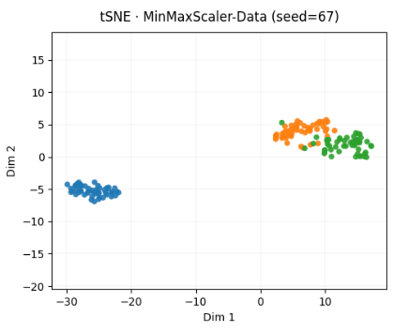
Iris Data t-SNE with MinMax Scaler

Slide 10
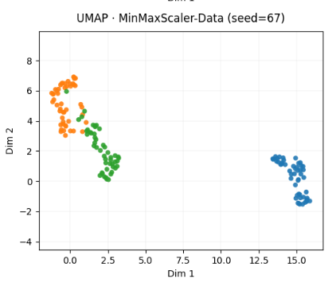
Iris Data UMAP with MinMax Scaler

Slide 11
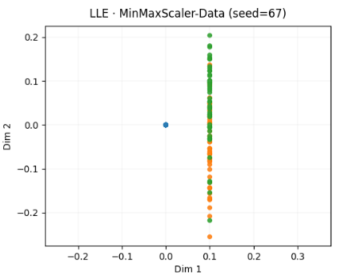
Iris Data LLE with MinMax Scaler

Slide 12
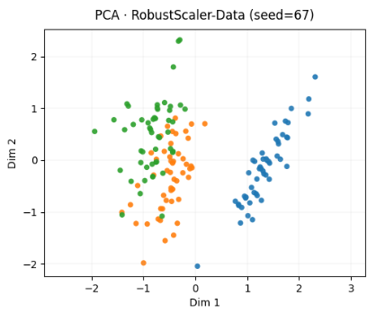
Iris Data PCA with Robust Scaler

Slide 13
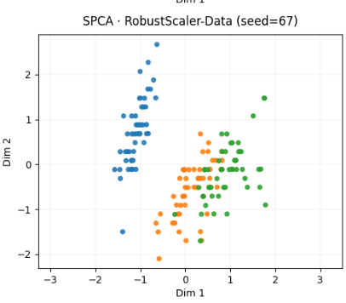
Iris Data SPCA with Robust Scaler

Slide 14
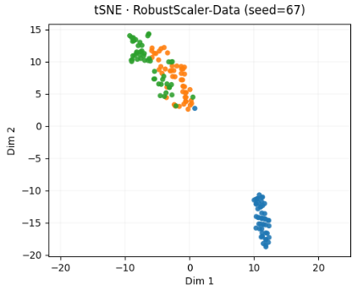
Iris Data t-SNE with Robust Scaler

Slide 15
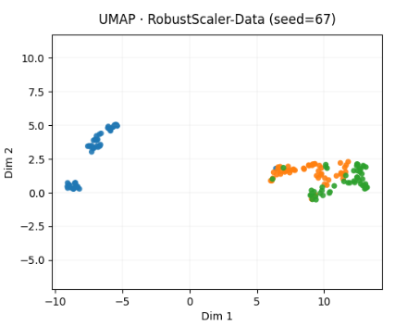
Iris Data UMAP with Robust Scaler

Slide 16
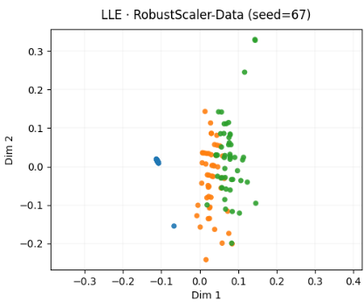
Iris Data LLE with Robust Scaler

Slide 17
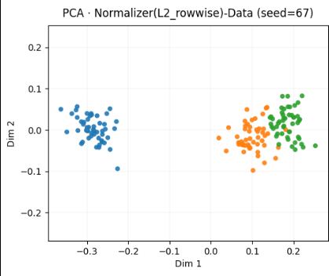
Iris Data PCA with L2 Normalizer

Slide 18
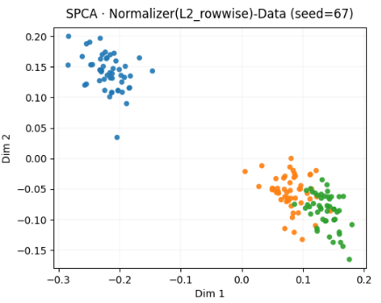
Iris Data SPCA with L2 Normalizer

Slide 19
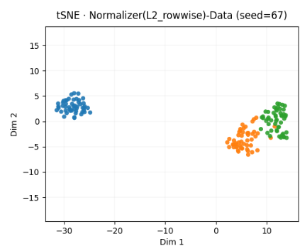
Iris Data t-SNE with L2 Normalizer

Slide 20
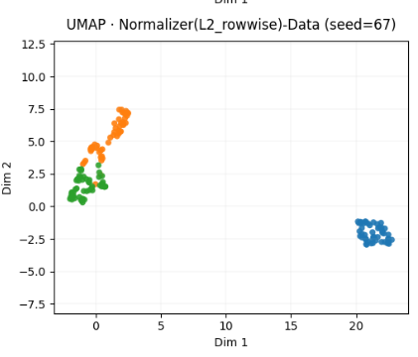
Iris Data UMAP with L2 Normalizer

Slide 21
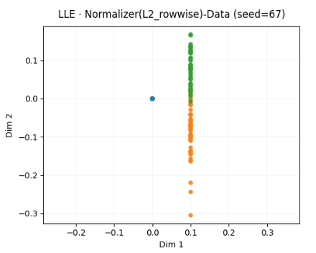
Iris Data LLE with L2 Normalizer

Slide 22
Analysis of Overall LCR Trustworthiness, Continuity
1. Overall Trends
Across all normalization–method combinations, Trustworthiness and Continuity range roughly between 0.75–0.86, indicating moderate to strong structure preservation. However, LCR values vary more widely (0.69–0.84), showing clear differences in neighborhood stability across methods.The best-performing configurations consistently use Normalizer(L2_rowwise) with UMAP or SPCA, achieving strong local and global balance.

Slide 23
Analysis of Overall LCR Trustworthiness, Continuity
2. Top Local Preservation (Low LCR, High Trustworthiness)
- Normalizer(L2_rowwise)-Data + UMAP: Trustworthiness 0.8634, LCR 0.6933 — Best local preservation; UMAP tightly preserves neighborhood structure.
- Normalizer(L2_rowwise)-Data + SPCA: Trustworthiness 0.8536, LCR 0.7167 — Strong local structure with slightly higher LCR; good linear balance.
- StandardScaler-Data + LLE: Trustworthiness 0.7974, LCR 0.7013 — Decent but less stable than nonlinear methods.

Slide 24
Analysis of Overall LCR Trustworthiness, Continuity
3. Best Global Preservation (High Continuity)
- Normalizer(L2_rowwise)-Data + UMAP: Continuity 0.8635 — Best global preservation among nonlinear methods.
- Normalizer(L2_rowwise)-Data + SPCA: Continuity 0.8536 — Nearly identical Continuity; well-balanced global retention.
- MinMaxScaler-Data + LLE: Continuity 0.7961 — Weaker global geometry retention.

Slide 25
Analysis of Overall LCR Trustworthiness, Continuity
Interpretation:
UMAP and SPCA both preserve global relationships effectively, with UMAP slightly ahead. LLE distorts the global manifold more severely, reflected in its lower Continuity.

Slide 26
Analysis of Overall LCR Trustworthiness, Continuity
4. Combined Preservation
UMAP under L2 normalization provides the most consistent local and global fidelity, yielding the top composite preservation score (≈0.307). SPCA follows with 0.283, while LLE trails at ≈0.299.

Slide 27
Analysis of Overall LCR Trustworthiness, Continuity
5. Summary Paragraph
Across all embedding–normalization combinations, UMAP (L2-normalized) demonstrated the strongest neighborhood and manifold preservation. It achieved the highest Trustworthiness (0.863), highest Continuity (0.863), and lowest LCR (0.693), confirming excellent balance between local and global structure. SPCA (L2-normalized) closely followed, offering strong linear stability with slightly higher LCR. LLE, while adequate, underperformed in Continuity and Preservation, suggesting overcompression in small neighborhoods. Conclusion: UMAP with L2 normalization is the most faithful embedding overall, capturing both fine-grained local neighborhoods and broader global structure.

Slide 28
Analysis of Overall LCR Trustworthiness, Continuity
6. Key Takeaways
- Local fidelity: UMAP < SPCA < LLE (by LCR & Trustworthiness)
- Global fidelity: PCA/SPCA ≈ UMAP > LLE
- Overall best balance: UMAP (L2 normalization)
- Interpretation: UMAP minimizes local distortion without sacrificing global layout—ideal for manifold visualization and cluster-based analysis.

Slide 29
Drug Discovery Analysis
1. Dataset Overview
The dataset contains 555 cell lines measured across 98 drugs (IC50 values). After median imputation and wide-format setup, each cell’s response profile represents its overall drug sensitivity pattern.Cells were labeled into binary sensitivity groups based on each drug’s median IC50 (sensitive = below median, resistant = above median). These binary labels allow visualization of how well dimensionality-reduction methods separate sensitive vs resistant profiles.

Slide 30
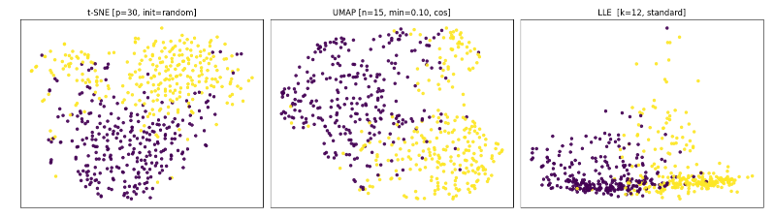
Drug Discovery Analysis: t-SNE, UMAP, and LLE visualizations

Slide 31
Drug Discovery Analysis
2. PCA Visualization and Outlier Detection
Goal: Identify broad trends and potential outlier cells.
Findings:
- PCA reveals a dominant axis driven by overall drug potency differences.
- A few cells appear far from the dense center in PC1–PC2 space, representing extreme sensitivity or resistance across multiple drugs.
- These outliers likely correspond to cell lines with atypical drug-response patterns (multi-drug-resistant or hypersensitive types).

Slide 32
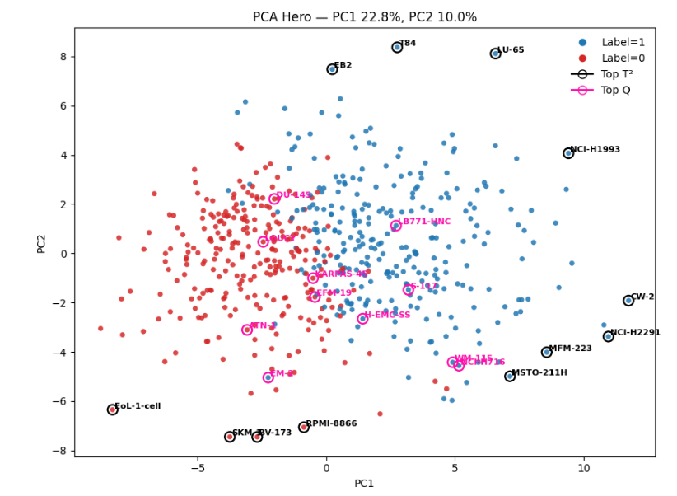
Drug Discovery Analysis (PCA Plot)

Slide 33
Drug Discovery Analysis
3. Nonlinear Embeddings (t-SNE, UMAP, LLE)
t-SNE [p=30, init=random]: Clear local separation; clusters overlap slightly. DBSCAN isolates 3–5 dense regions; sensitive/resistant partially mixed.
UMAP [n=15, min_dist=0.10, metric=cosine]: Strong two-cluster geometry. DBSCAN captures two major clusters aligning with binary labels.
LLE [k=12, standard]: Flattened structure; elongated along one axis. DBSCAN finds one dominant cluster plus scattered outliers.

Slide 34
Drug Discovery Analysis
4. Quantitative Preservation Metrics (Summary)
UMAP (n=15, min_dist=0.10) yielded the lowest LCR (≈0.69) and highest Trustworthiness/Continuity (≈0.86/0.86) — consistent with its visually coherent clusters.
SPCA and PCA maintained global variance but lost fine neighborhood detail (higher LCR, lower Trustworthiness).
LLE showed the weakest preservation metrics overall (local collapse).

Slide 35
Drug Discovery Analysis
5. Combined Interpretation
The drug-response manifold is partially separable into sensitive vs resistant regions, confirming that IC50 profiles contain learnable structure.
UMAP best reflects this topology, giving clusters that DBSCAN can reliably identify.t-SNE complements UMAP when emphasizing local sub-clusters or secondary drug-mechanism patterns.
PCA remains useful for spotting global outliers and variance directions tied to broad pharmacological effects.

Slide 36
Drug Discovery Analysis
6. Conclusion
In the drug-discovery dataset, UMAP with cosine distance (n=15, min_dist=0.10) provided the most faithful and interpretable embedding.
It simultaneously maximized local preservation (low LCR) and global consistency (high Continuity), resulting in clear two-group structure corresponding to drug sensitivity.
DBSCAN clustering on this embedding captured the biological partitioning most effectively, while t-SNE highlighted finer substructure and LLE failed to maintain neighborhood geometry.
Overall, nonlinear embeddings—especially UMAP—translate the high-dimensional drug-response space into a biologically meaningful 2-D layout suitable for exploratory clustering and downstream predictive modeling.

Slide 37
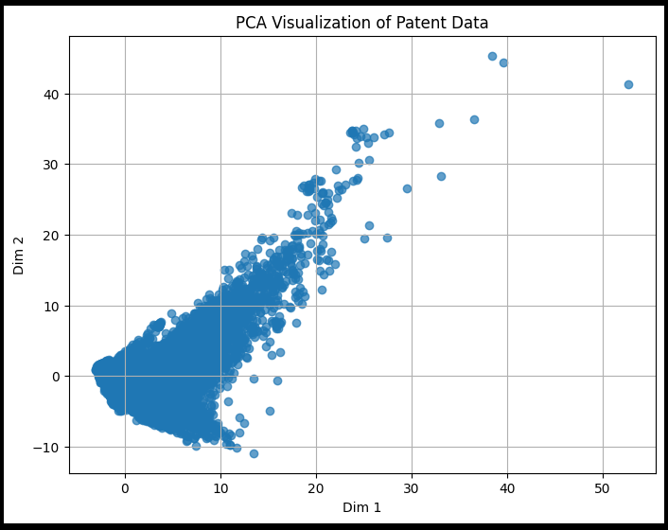
Patent Data PCA

Slide 38
Special Patents in Patent Data PCA

Slide 39
Patent Data t-SNE

Slide 40
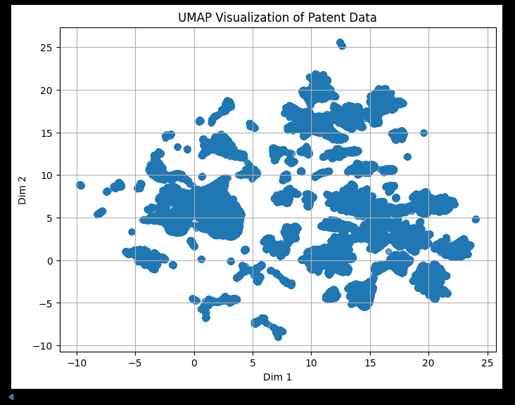
Patent Data UMAP

Slide 41
Patent Data PHATE

